Slide 1
Capstone Project
Airbnb Bookings Analysis by Ganesh Bayas Data Science Trainee AlmaBetter, Bengaluru

Slide 2


Since 2007, Airbnb operates an online marketplace for lodging, homestays & tourism activities.
Introduction

Slide 3
id unique id
latitude coordinate
name representing an accommodation
Dataset Information
(48895, 16)
longitude coordinate
host_id unique id for host
neighbourhood_group a group of area, 5 unique hoods
neighbourhood falls under group
price price of property
calculated_host_listing_count no of registered listing under a host
Null count:
name - 16
host_name – 21
last_review – 10052
reviews_per_month - 10052
room_type 3 unique room types
availability_365 number of days a host is available
minimum_nights minimum nights stay required
number_of_reviews total rating count of a listing
reviews_per_month rate of review given per month
last_review date of last review given

Slide 4
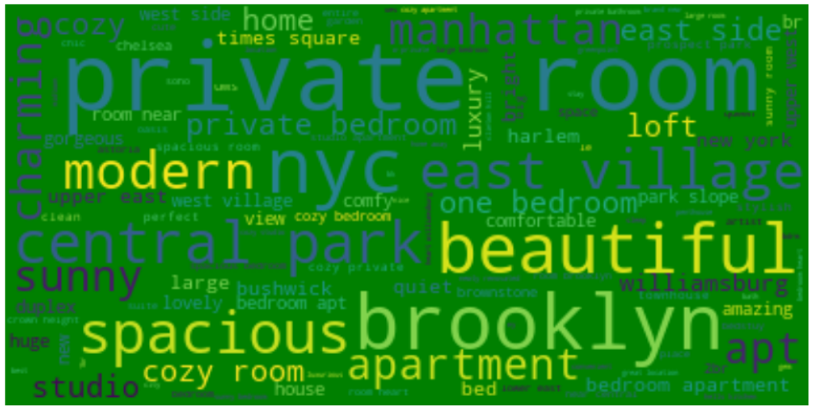
Wordcloud Image
WordCloud
It shows all the frequently used words in dataset.

Slide 5
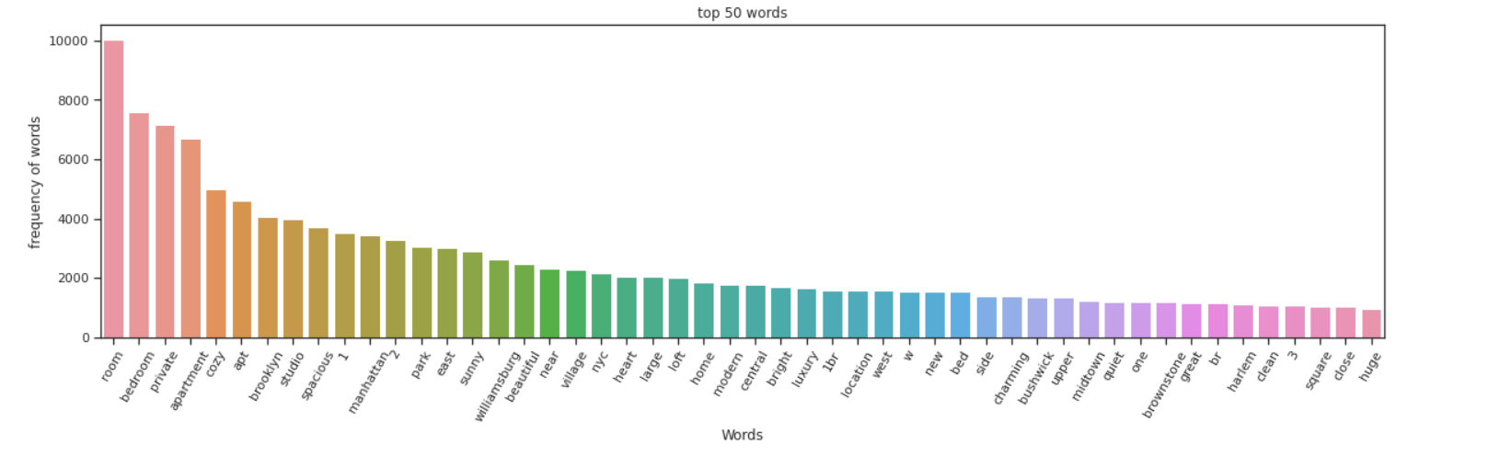
Top 50 words
The above observation shows top 50 words with their frequency.

Slide 6
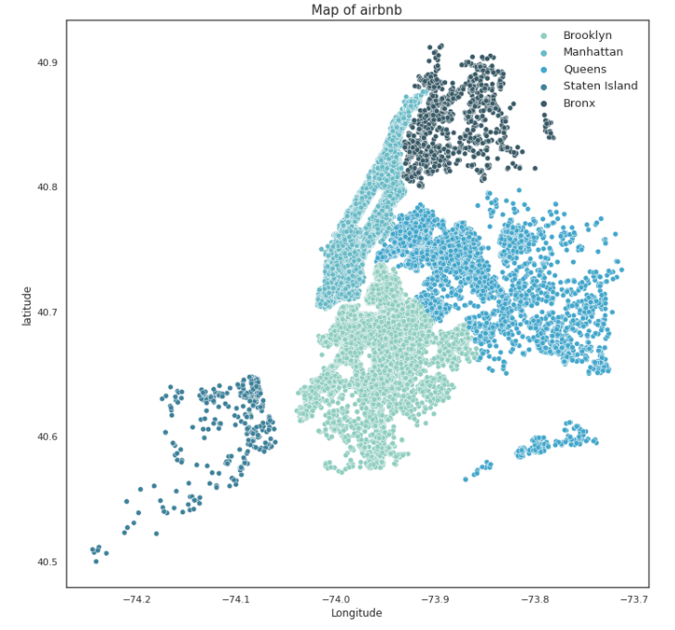
Location of Neighbourhood Groups
5 unique groups :
--------------------------
Manhattan
Brooklyn
Queens
Staten Island
Bronx
There are 211 unique neighbourhoods falls under 5 groups

Slide 7
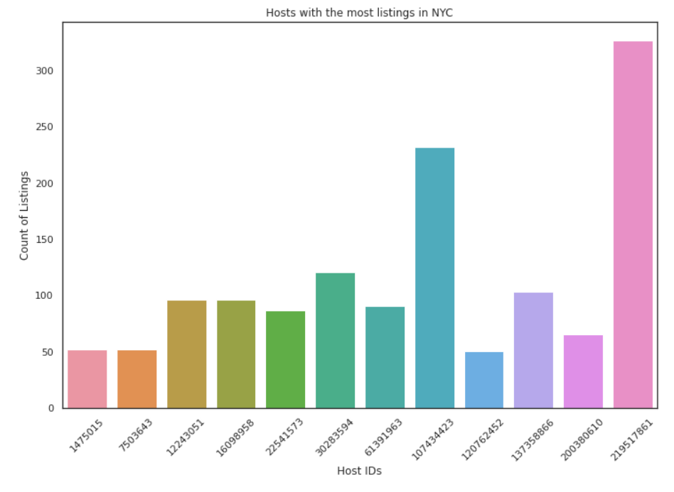
Host with most listings in NYC
The above bar chart shows Hosts with the most listings in NYC it also shows distinct host ids with number of listings.

Slide 8
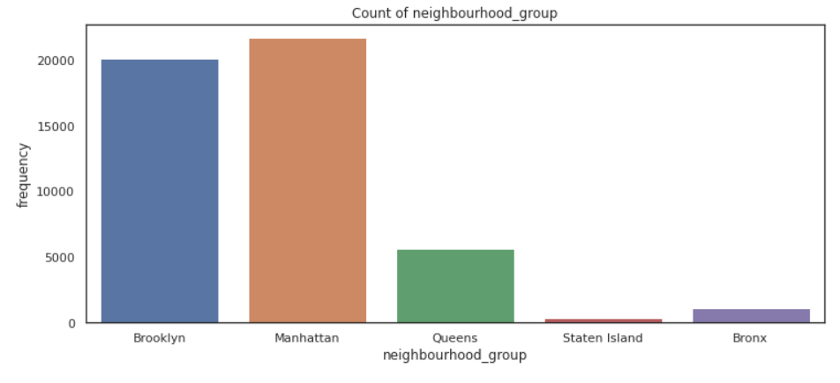
Neighborhood Group analysis
The above chart shows neighbourhood groups booking frequency the highest bookings are in Brooklyn and manhattan.

Slide 9
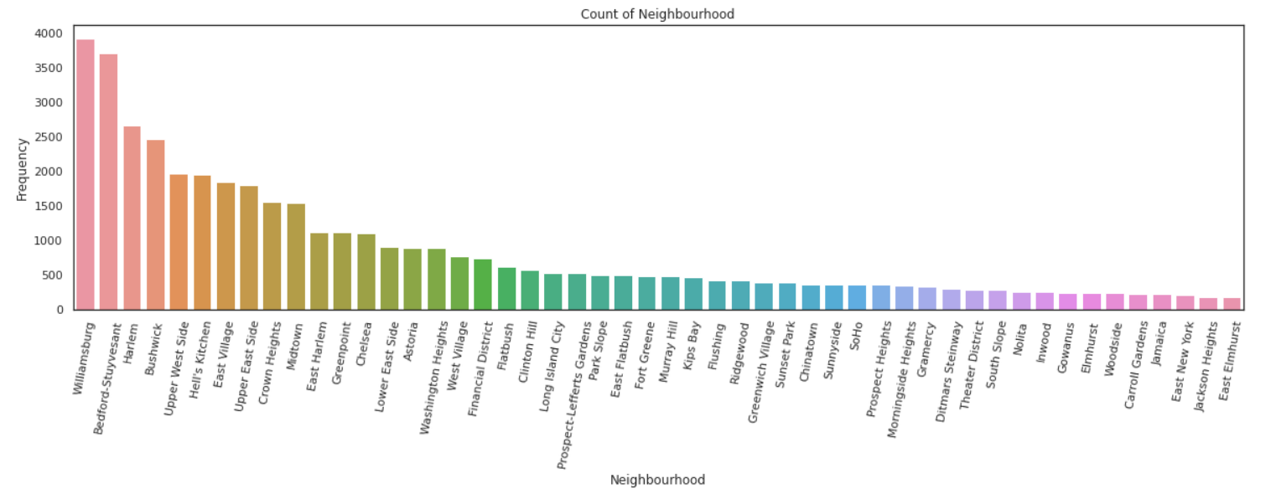
Neighbourhood demand chart
The above chart shows us neighborhood towns with the highest and lowest demand from customers across the platform.

Slide 10
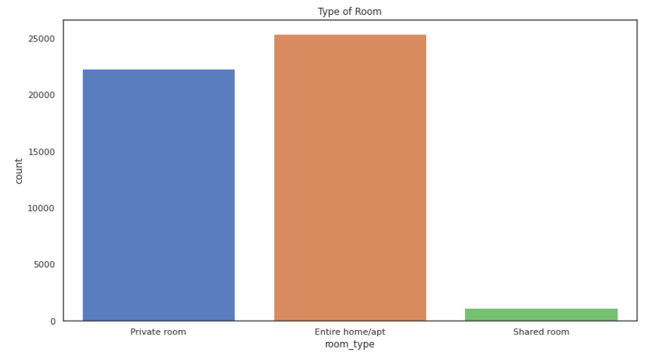
Room type demand analysis
Shared rooms are the cheapest
The above chart shows there are 3 types of rooms in which entire home/apt having highest demand followed by private room then shared room.

Slide 11
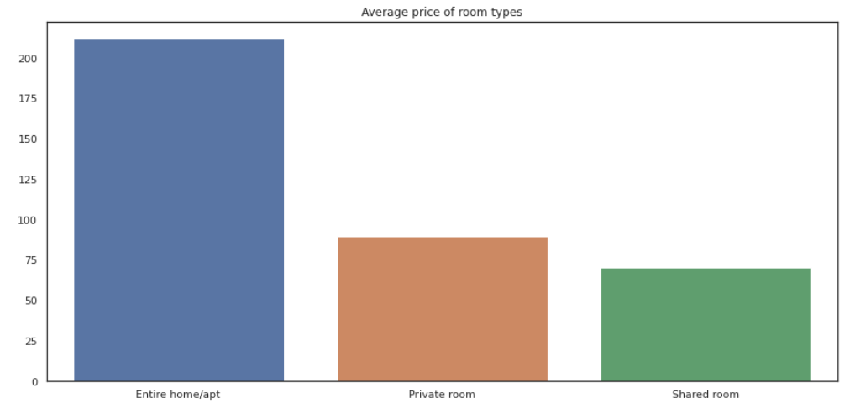
Price analysis of Room types
In above chart Entire home/apt has more than 50% avg cost private room and shared room avg cost is not having price difference morethan 20%.

Slide 12
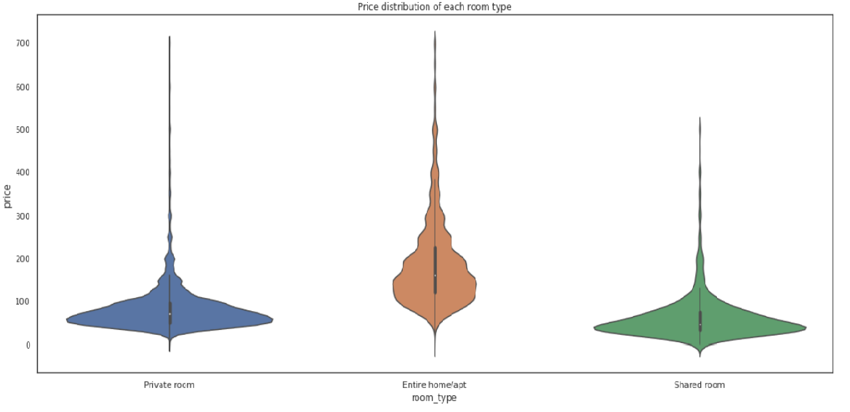
Price distribution analysis
we have considered to divide the whole price range into three categories
1.cheep (price range below or equal to 80$)
2.Affordable(for price range 80 to 500$)
3.Expensive(for price range more then 500$)
so, it look like people have more intrest in having "affordable" rooms/apartments rather than having cheap and expensive rooms

Slide 13
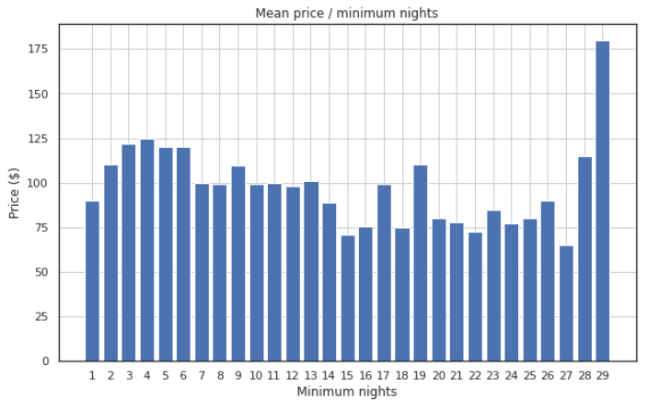
Mean price per night analysis
It's generally cheaper to stay in rooms between 14 and 28 nights.
Usually, the minimum required nights to stay in a room is around 2.

Slide 14
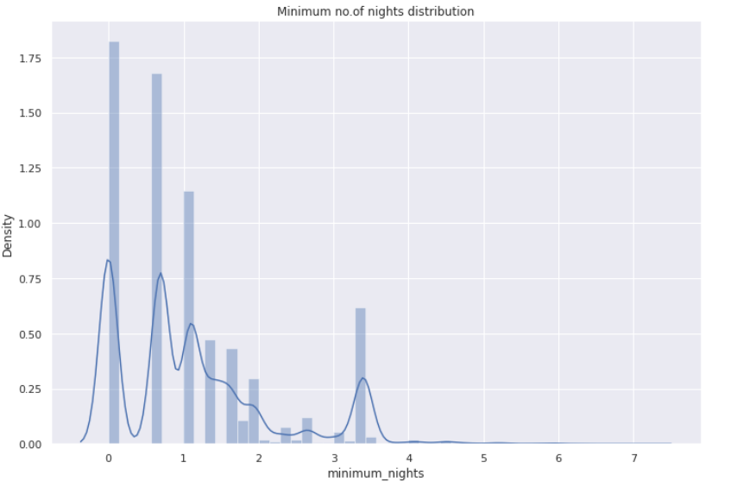
Minimum no of nights distribution
This plots shows that majority of room booking is one for 1 to 4 days. Box-Cox transformed plot strictly shows that the majority of booking lies between 0 to 3 days.

Slide 15
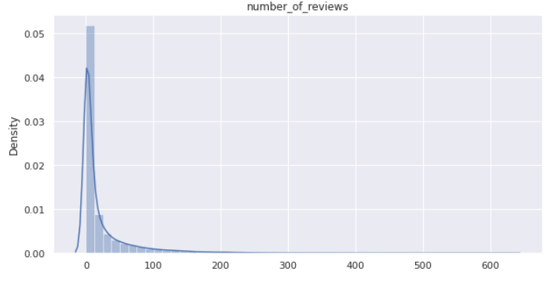
Distribution of number of reviews
Number of reviews are highly dense from 0 to 100 reviews. We can say that most of the rooms are not rated and those which are frequently occupied only those are rated.

Slide 16
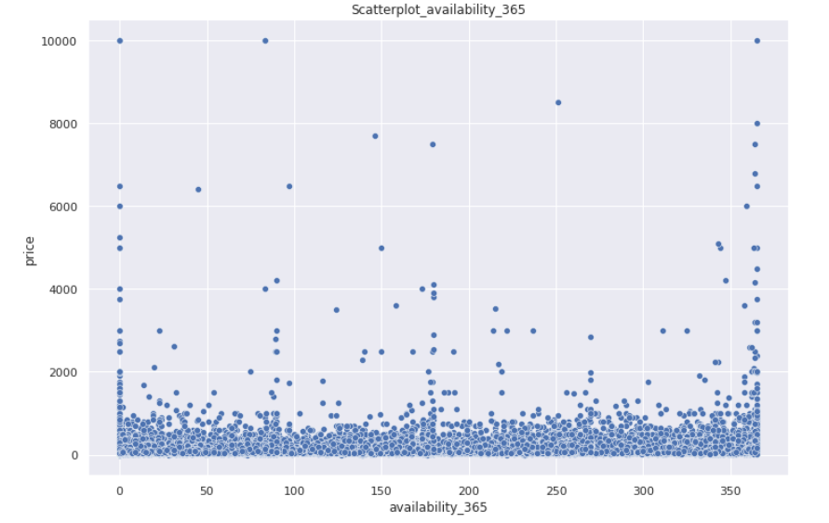
365 days availability analysis
From above plot we can see that most of the available rooms are in the range of 0 to 2000. Very few are available for price above 2000$,this is quite obvious that there are very few peoples who prefer to have expensive Rooms

Slide 17
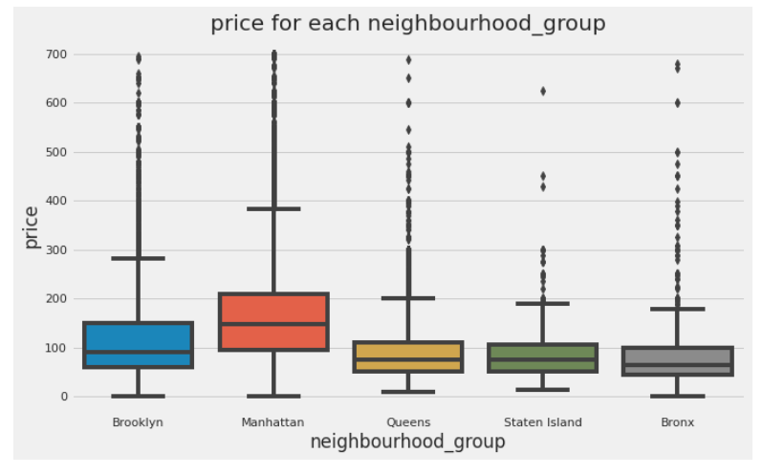
Neighbourhood group wise price analysis
We can see that Manhattan is the most expensive destination immediately followed by Brooklyn. Queens, Staten island and Bronx, are having price range less as compared to other two. we know no of reviews is directly proportional to no of guests.

Slide 18
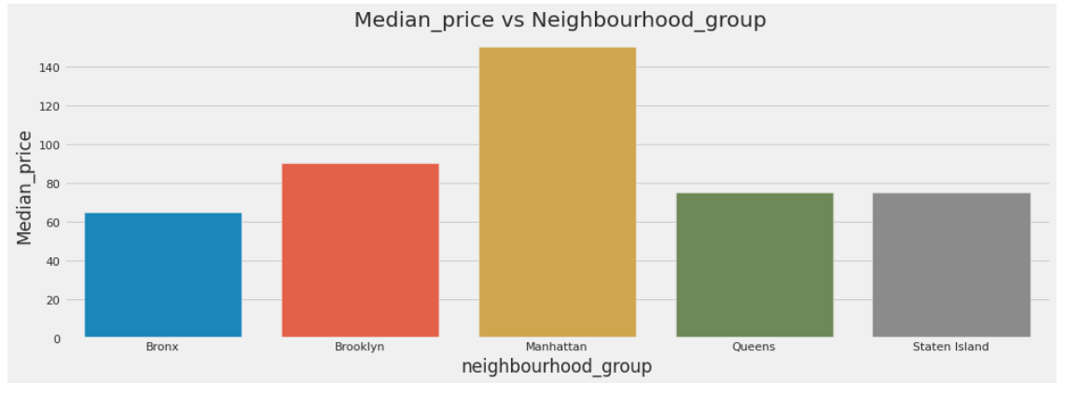
Neighbourhood group mean price analysis
Above chart shows neighborhood wise median prices as we can see Manhattan is the most expensive neighborhood group with $145 followed by Brooklyn then Queens, staten islands, Bronx.

Slide 19
Limitation
Dataset features in terms of modern world, are of very poor quality in deciding the valuation of a property
User ratings of hosts aren’t available, it would’ve been better to rank our hosts based on user
satisfaction and ratings. Normally a low rated property tends to lower their price
In order to have a better analysis regarding the quality of the properties, it would be interesting if we had an analysis of sentiments with property valuations.
The exact number of guests count also missing

Slide 20
Scope of Improvement
As dataset has few qualifying attributes to value a property, more features can be added like bedroom, bathroom, property age (it might be one of the most important one), applicable tax rate, distance to nearest airport, hospital or schools.
In presence of ratings, hosts can be classified and ranked, special discount or offer can be
given to highest rated hosts following marketing strategy
Time series analysis can be done to make prediction on occupancy rate based on tourist
season

Slide 21
Conclusion
Most visitors don’t prefer shared rooms, they tend to visit private room or entire home.
Comparing the price/popularity variables suggests that people who travel and use Airbnb tend to prefer listings that are cheaper.
Have a room "close" to things that affect popularity (it might be a good idea to include those words in the room name).
NYC shared rooms tend to be clustered in the city center, perhaps because there are more travelers who want to visit the most famous cities.

Slide 22
Thank You

